Slide 1
Behavior System
Class and School
Mrs. Clow Third Grade

Slide 2
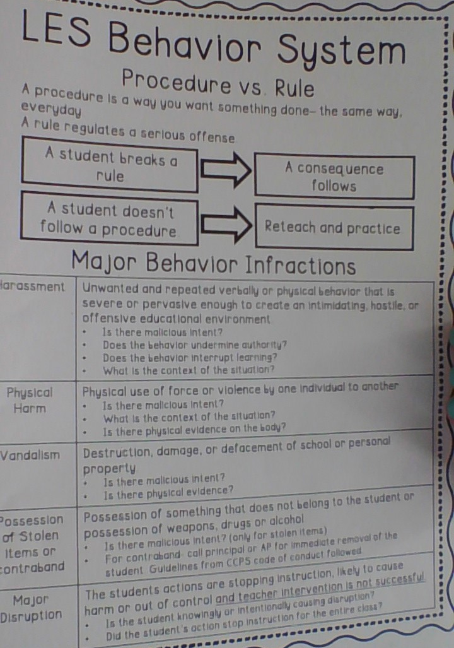
LES Behavior System
Explains the difference between a procedure and a rule
Points out major behavior infractions

Slide 3
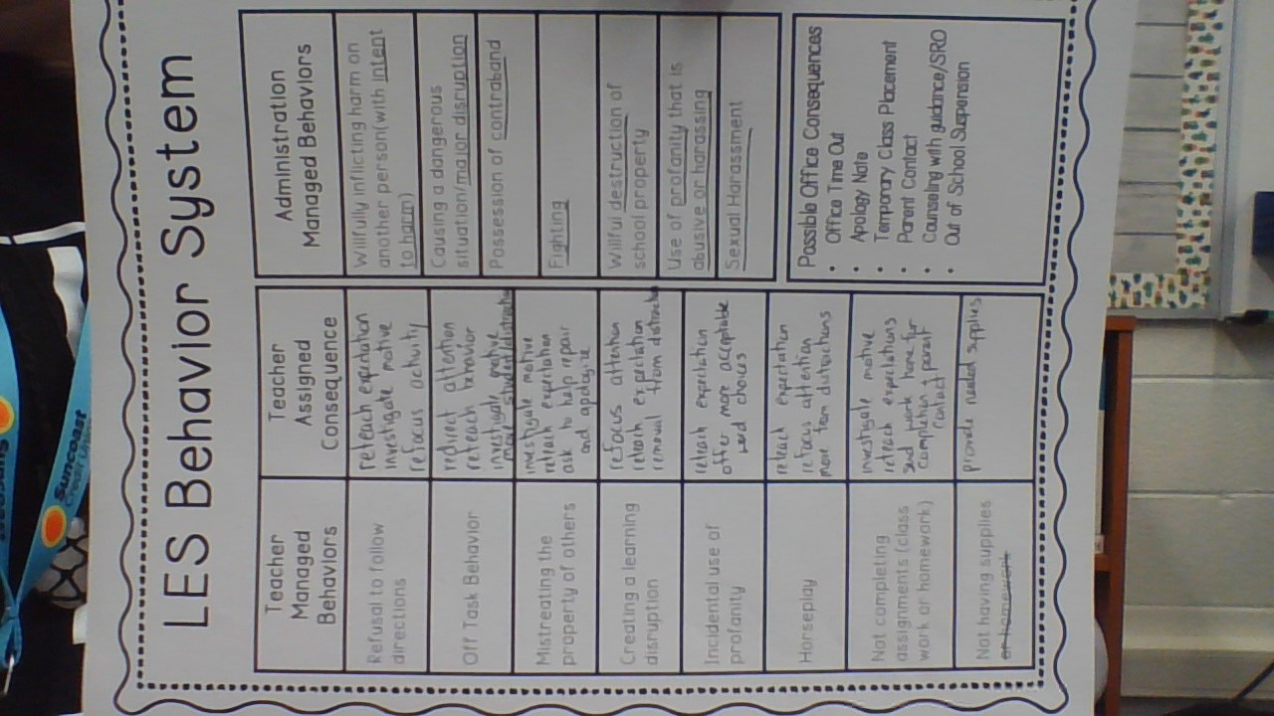
LES Behavior System
Details some behaviors managed in the classroom and how I handle those behaviors.
These steps are are for small things that students may do and how I would respond to them.
Some behaviors cannot be handled in the classroom because they require a higher level of intervention.

Slide 4
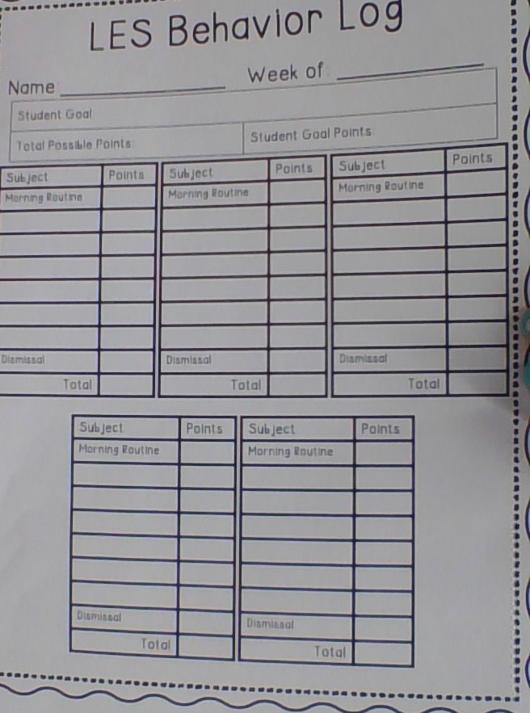
Behavior Log
Weekly behavior log will be used as needed to track specific student behaviors. This will be used as an intervention and communicated to the parent and administration.

Slide 5
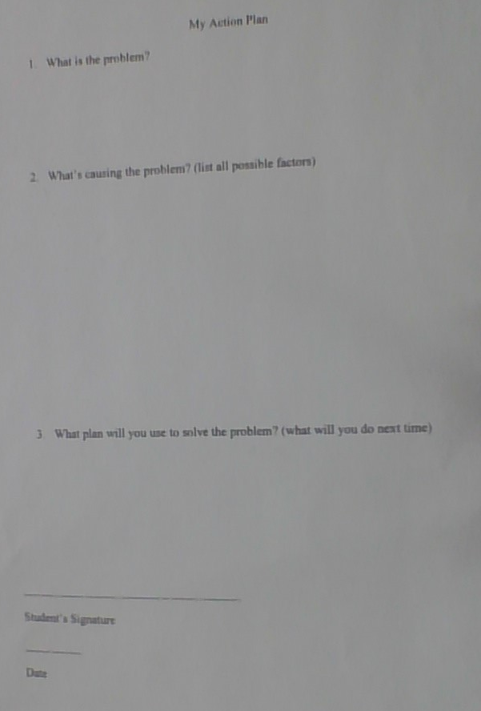
Student Action Plan
Student behaviors are often motivated by a source we cannot see. This form will help me to understand the root of the behavior.
If students have a hard time filling this out on their own, myself or a trusted adult will help them.

Slide 6
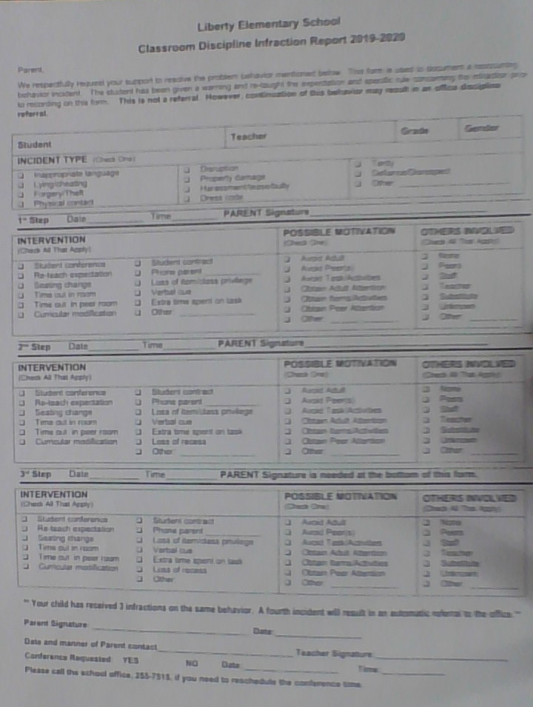
Infraction Form
An infraction form is used to track a specific type of behavior. If a new behavior occurs then a different form is used.
This form stays in the classroom unless the student get to 4 incidences of the same behavior.
If you get this form please sign and return to school. If the behavior does not repeat, the form goes away at the end of the year and will not result in an office referral.
I will contact you on Remind prior to sending this home so that you know it is coming.
Used for prevention and to track repeated behaviors so that we can HELP students.
I am all about prevention, not punishment.

Slide 7
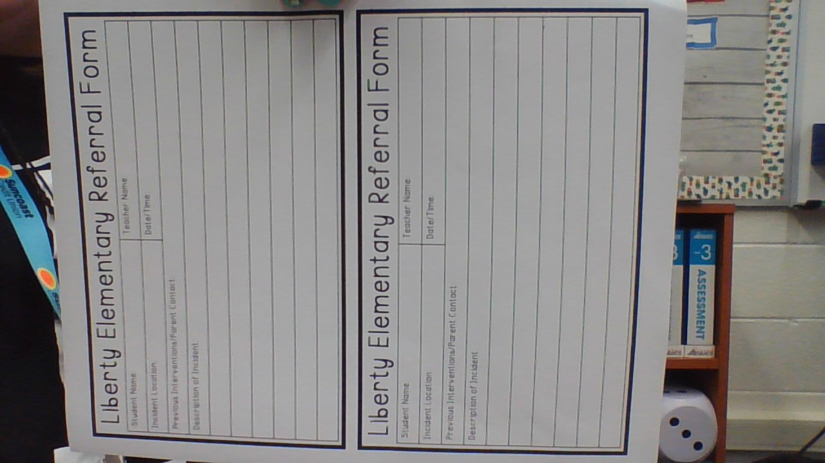
Referral Form
If a behavior is sever enough, an office referral will be filled out and the student will be sent to the office.
This does not always end up being written up in Focus as Admin makes the decision on the best action plan.

